Slide 1

Object Oriented Programming (Features and comparative studies)
By Rajarshi Mandal

Slide 2
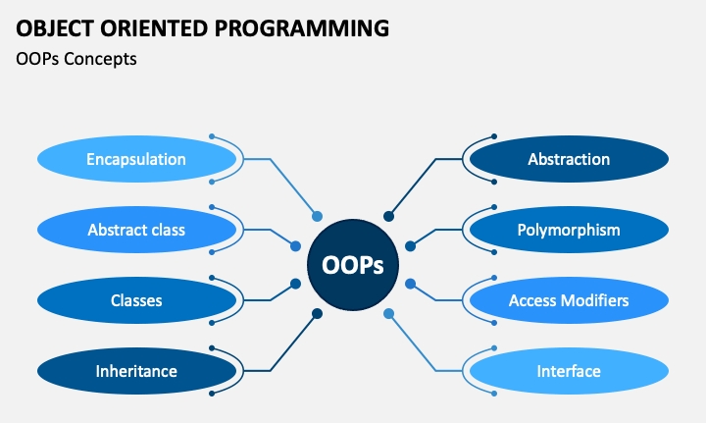
Background:
There are several approaches to programming paradigms. But the two most popular and important ones are procedural programming and object-oriented programming. From a beginner’s point of view, procedural programming is easier to learn and more simple to use. But as your application grows and your codebase becomes larger, development and maintenance of your code becomes more difficult. This is where OOP comes to the rescue. OOP makes your code easier to debug and provides better flexibility and reusability. The ever-growing popularity of Object Oriented Programming and Object Oriented Languages stand to testify the benefits of the paradigm.
& many more…

Slide 3
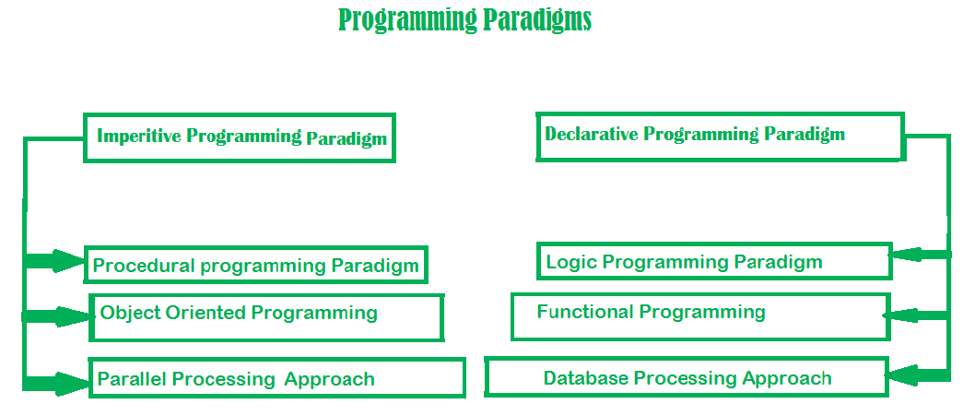
Programming Paradigm:
Programming Paradigm can also be termed as method to solve some problem or do some tasks. Programming paradigm is an approach to solve problem using some programming language or also we can say it is a method to solve a problem using tools and techniques that are available to us following some approach. There are lots for programming language that are known but all of them need to follow some strategy when they are implemented and this methodology/strategy is paradigms.

Slide 4
What is a Procedural Programming ?
Procedural programming is also a programming paradigm based on the concept of the procedure call. It is derived from structured programming. Procedures are simply a series of steps to be followed. Some of the first procedural programming languages were Fortran, ALGOL, C etc. The computer processors provide hardware support to procedural programming through a stack register and also provide instructions for calling procedures and returning from the stack.
Procedural programming languages are also imperative languages to make explicit references to the state of the execution environment. The major difference between these is procedural programming depends on blocks and scope whereas imperative programming may have or not have these features.
What is a Object-Oriented Programming ?
Object-Oriented Programming (OOP) is a programming paradigm based on the concepts of “objects” which can contain data (also known as attributes or properties) in the form of fields, and code that is in the form of procedures (also known as methods or functions).
Many of the most widely used programming languages (such as C++, Java, Python, etc.) are multi-paradigm and they support object-oriented programming to a greater or lesser degree, typically in combination with imperative, procedural programming. Significant object-oriented languages include: Java, C++, C#, Python, R, PHP, Visual Basic.NET, JavaScript, Ruby, Perl, SIMSCRIPT, Object Pascal, Objective-C, Dart, Swift, Scala, Kotlin, Common Lisp, MATLAB, and Smalltalk.
OOPSLA is the annual conference for Object-Oriented Programming Systems, Languages and Applications.

Slide 5
In both programming paradigms; things having different nomenclatures, though having similar semantics:
Procedural Programming | Object-oriented Programming
Procedure | Method
Record | Object
Module | Class
Procedure call | Message
Differences between these two types of programming:
Procedural Programming | Object-oriented Programming
It focuses on the process and functions. | It focuses on the data and classes.
It is not easy to maintain. | It is easy to maintain.
In this paradigm, if a sub-procedure has to be modified, it becomes difficult to find and maintain it. | In this paradigm, it is easy to maintain code and modify existing code.
Due to its complexity, development time increases. | Due to easy maintenance, development time reduces.
Procedural programming languages are not as faster as object-oriented. | The object-oriented programming languages are faster and more effective.
It focuses on procedure rather data which has priority in data-driven systems. | It focuses on data rather than procedures.
In procedural programming, designs cannot be reused and recycled throughout the program. | In object-oriented programming, designs can be reused throughout the program.
While solving issues in procedural programming, issues need to be addressed individually. | In object-oriented programming, objects and classes can be referenced throughout the program.

Slide 6
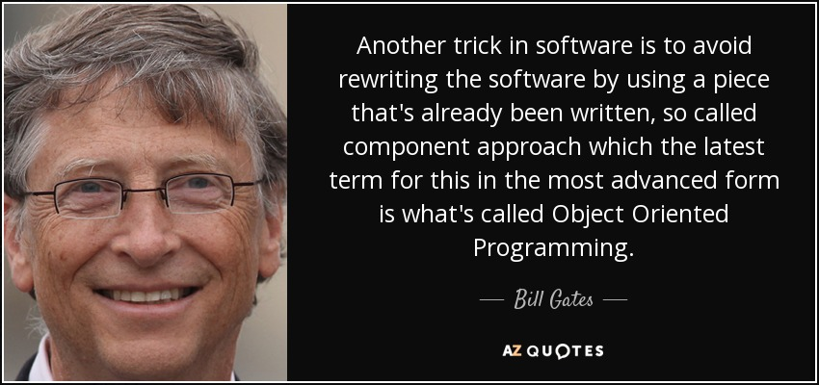

Disadvantages Of Procedural Programming:
Procedural programming major disadvantage includes lack of code reusability. It doesn’t let programmer reuse the same code again throughout the program. Programmer needs to type the same code at many applications which adds to the time and redundancy in a project. Addition to it there is no security for user’s data in procedural programming because operations on data is more important to it than data itself.

Slide 7
Benefits Of Object Oriented Programming:
We can build the programs from standard working modules that communicate with one another, rather than having to start writing the code from scratch which leads to saving of development time and higher productivity,
OOP language allows to break the program into the bit-sized problems that can be solved easily (one object at a time).
The new technology promises greater programmer productivity, better quality of software and lesser maintenance cost.
OOP systems can be easily upgraded from small to large systems.
It is possible that multiple instances of objects co-exist without any interference,
It is very easy to partition the work in a project based on objects.
It is possible to map the objects in problem domain to those in the program.
The principle of data hiding helps the programmer to build secure programs which cannot be invaded by the code in other parts of the program.
By using inheritance, we can eliminate redundant code and extend the use of existing classes.
Message passing techniques is used for communication between objects which makes the interface descriptions with external systems much simpler.
The data-centered design approach enables us to capture more details of model in an implementable form.

Slide 8
Difference between Class and Structure:
Class | Structure
Classes are of reference types. | Structs are of value types.
All the reference types are allocated on heap memory. | All the value types are allocated on stack memory.
Allocation of large reference type is cheaper than allocation of large value type. | Allocation and de-allocation are cheaper in value type as compare to reference type.
Class has limitless features. | Struct has limited features.
Class is generally used in large programs. | Struct are used in small programs.
Classes can contain constructor or destructor. | Structure does not contain parameter less constructor or destructor, but can contain Parameterized constructor or static constructor.
Classes used new keyword for creating instances. | Struct can create an instance, with or without new keyword.
A Class can inherit from another class. | A Struct is not allowed to inherit from another struct or class.
The data member of a class can be protected. | The data member of struct can’t be protected.
Function member of the class can be virtual or abstract. | Function member of the struct cannot be virtual or abstract.
Two variables of class can contain the reference of the same object and any operation on one variable can affect another variable. | Each variable in struct contains its own copy of data(except in ref and out parameter variable) and any operation on one variable cannot affect another variable.

Slide 9
Four Pillars of OOP: Abstraction, Encapsulation, Inheritance and Polymorphism
Abstraction: It is the key concept in the domain of object-oriented programming. It enables the programmer to abstract or we can say, it hides details from the users. In today’s world of technology privacy i.e., hiding the information is everyone’s demand. There are many advantages of abstraction, such as:
It makes the complex logic hide behind and makes the system easy to use for a user.
It allows the particular code to be efficiently reused while avoiding complexity.
It ensures the security of the system, like passwords and usernames.
Encapsulation: It is a process of binding data members and member functions into a single unit, where data members are variables or properties and member functions are methods. In simple language, encapsulation can be understood by the example of a factory.
Assume a juice factory. It has various segments for different kind of juices such as apple juice, orange juice and grapes juice. Each segment has a juicer(function) and a storage unit of fruits(data). Now think if you place oranges in the apple juicer, it would break the system. So, to ensure that the factory runs efficiently it is made sure that apples are stored in the storage of the segment having apple juicer and accordingly for other segments. This will ensure the smooth running of the factory. So, you can say that the factory was encapsulated.

Slide 10
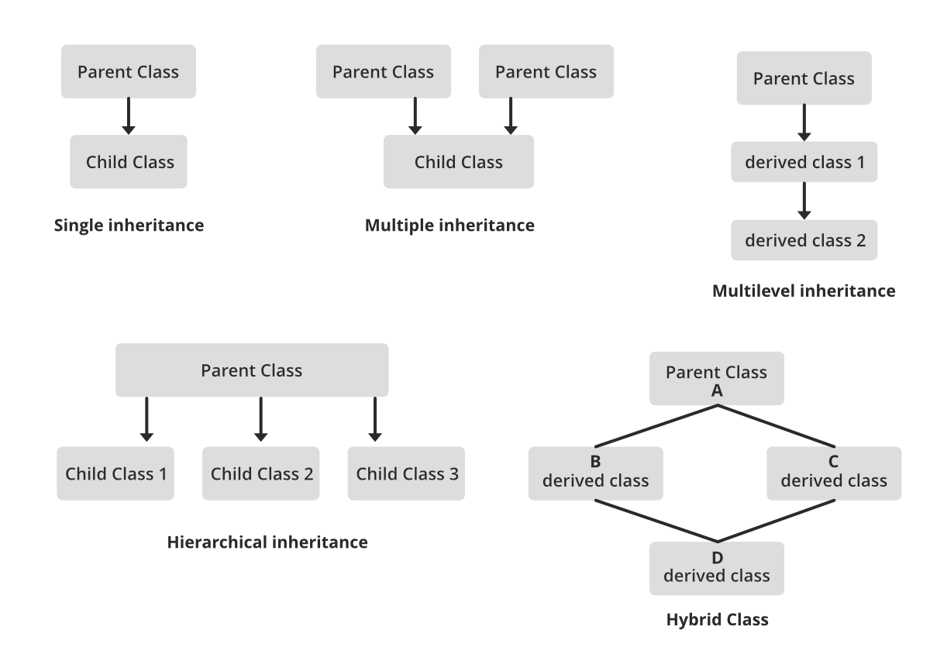
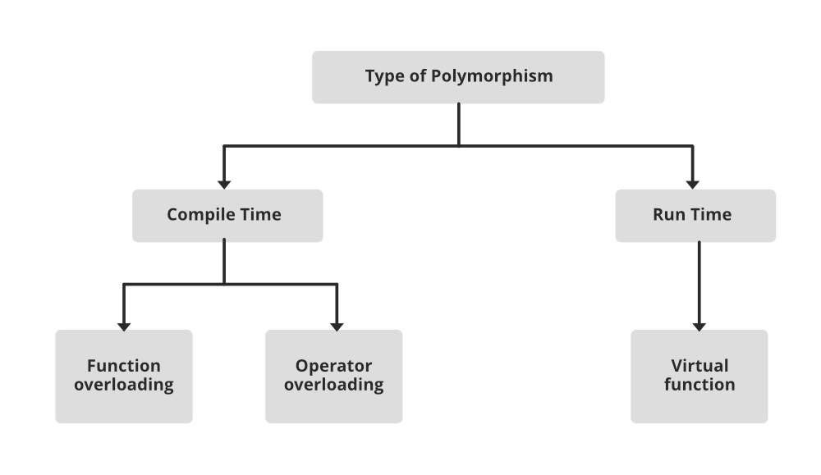
Inheritance: It is the process to create new classes or subclasses from an existing class. The existing class is called the Parent Class or Base Class, and the derived class is called Sub-Class or Inherited Class or Derived Class. The inherited class have the behaviour of parent class, and in addition, can have its own characteristics.
For Example, if we have Animal as a Parent class, then we can create Cat, Dog classes inherited from the Parent class because Dog and Cat have one thing in common: they both are animals and will have properties of animals, which means properties defined in Animal class (Parent class).
Polymorphism: It means taking many forms. Polymorphism occurs due to inheritance. Polymorphism often saves you from the unnecessary creation of new functions with similar functionality but a different number of arguments or inputs.

Slide 11
Now Let’s see a real life example of these concepts:
Let’s consider a Person,
The definition “Person” is like a class. It defines what a “person” is. He(/She) is a human being, he(/she) got a brain, hands legs etc…
The people are like an object. They obey the rules specified above (being a human being, having hands, legs etc…) ~ instances of the class
Artists could be viewed as a class inherited from “person” class. Artists have all the properties of persons, they also have additional features like, they can draw nice pictures.
An artist will have some understanding of pictures, colour combinations etc… like data inside an object. If you ask him to draw a nice picture(call the function to draw a picture), he draws(returns) a nice picture. The internal details like what was happening in his brain, movements of his fingers etc… are hidden to the you(user). ~ Abstraction. His understandings (data), fingers, ears (functions) etc… some how coordinate internally to provide a simple interface (ears: you can tell him) to you(user). ~ Encapsulation
At the same time, this artist can be a father, a husband, an employee. ~ Polymorphism

Slide 12
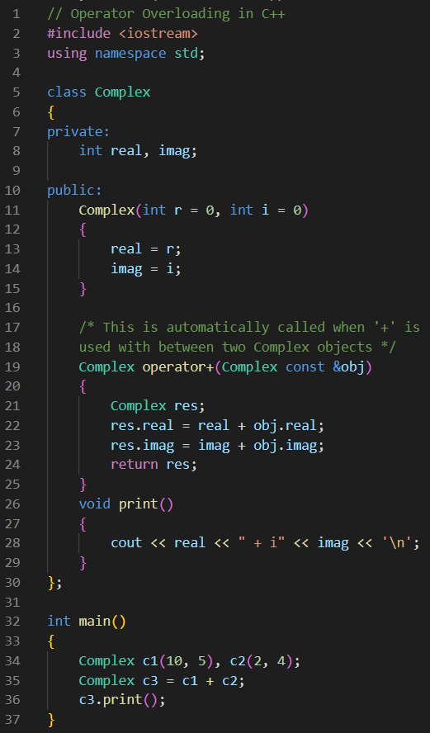
Operator Overloading:
In OOP Languages (like C++, C#, Python etc), we can make operators work for user-defined classes. It means these languages have the ability to provide the operators with a special meaning for a data type, this ability is known as operator overloading.
Almost all operators can be overloaded except a few. Following is the list of operators that cannot be overloaded.
sizeof
typeid
Scope resolution (::)
Class member access operators (.(dot), .* (pointer to member operator))
Ternary or conditional (? :)

Slide 13
Methods and Functions:
Once you have created objects, you want them to be able to do something. This is where methods come in. A method in object-oriented programming is a procedure associated with a class. A method defines the behaviour of the objects that are created from the class. Another way to say this is that a method is an action that an object is able to perform. The association between method and class is called binding. Consider the example of an object of the type 'person,' created using the person class. Methods associated with this class could consist of things like walking and driving. Methods are sometimes confused with functions, but they are distinct.
A function is a combination of instructions that are combined to achieve some result. A function typically requires some input (called arguments) and returns some results.
Objects and classes:
Languages that support object-oriented programming (OOP) typically use inheritance for code reuse and extensibility in the form of either classes or prototypes. Those that use classes support two main concepts:
Classes – the definitions for the data format and available procedures for a given type or class of object; may also contain data and procedures (known as class methods) themselves i.e., classes contain the data members and member functions
Objects – instances of classes

Slide 14
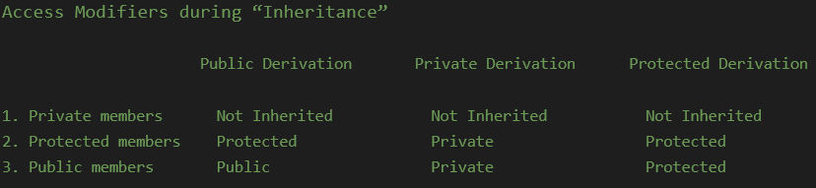
Data hiding:
It is a software development technique specifically used in object-oriented programming (OOP) to hide internal object details (data members). Data hiding ensures exclusive data access to class members and protects object integrity by preventing unintended or intended changes.
Access Modifiers:
Access modifiers (or access specifiers) are keywords in object-oriented languages that set the accessibility of classes, methods, and other members. Access modifiers are a specific part of programming language syntax used to facilitate the encapsulation of components.
In C++, there are only three access modifiers:
Private members/methods: Functions and variables declared as private can be accessed only within the same class, and they cannot be accessed outside the class they are declared.
Public members/methods: Functions and variables declared under public can be accessed from anywhere.
Protected members/methods: Functions and variables declared as protected cannot be accessed outside the class except a child class. This specifier is generally used in inheritance.

Slide 15
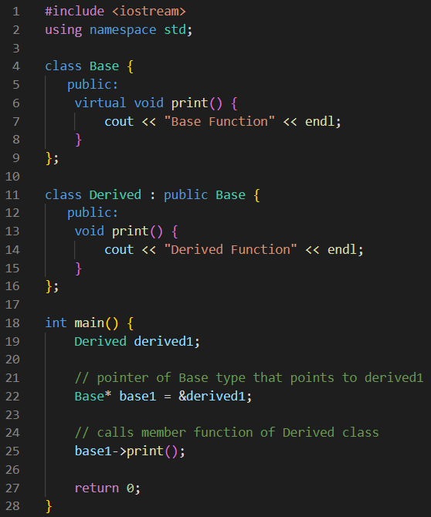
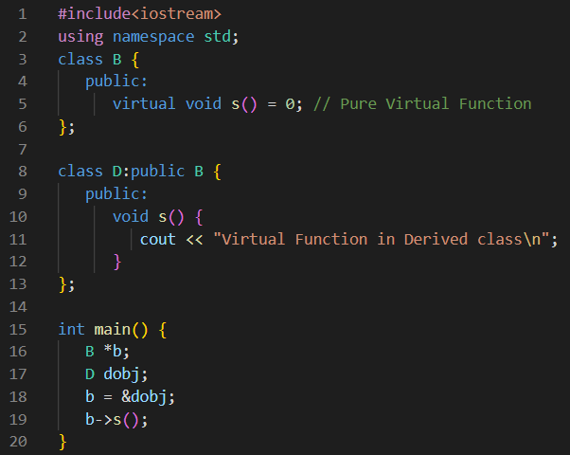
Virtual Functions:
The virtual keyword is useful in modifying a method, property, indexer, or event. When we have a function defined in a class that we want to be implemented in an inherited class(es), you use virtual functions. The virtual functions could be implemented differently in different inherited class and the call to these functions will be decided at runtime.
Abstract Functions:
An Abstract Function or Pure Virtual Function is a virtual function in C++ for which we need not to write any function definition and only we have to declare it. It is declared by assigning 0 in the declaration.

Slide 16
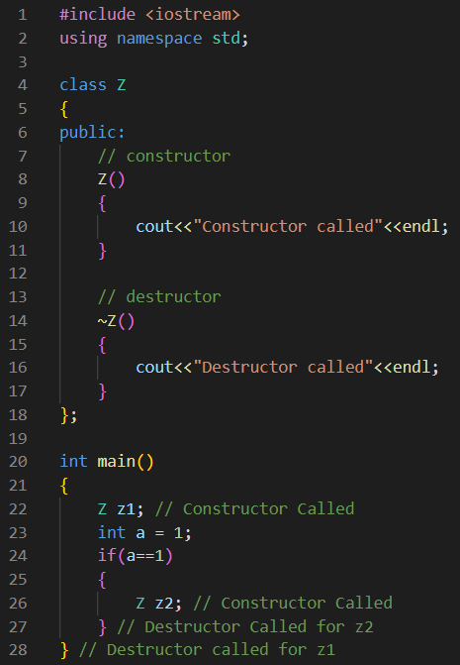
Constructor:
A constructor is a member function of a class that has the same name as the class name. It helps to initialize the object of a class. It can either accept the arguments or not. It is used to allocate the memory to an object of the class. It is called whenever an instance of the class is created. It can be defined manually with arguments or without arguments. There can be many constructors in a class. It can be overloaded but it cannot be inherited or virtual. It also does not return anything.
Destructor:
Like a constructor, Destructor is also a member function of a class that has the same name as the class name preceded by a tilde(~) operator. It helps to deallocate the memory of an object. It is called while the object of the class is freed or deleted. In a class, there is always a single destructor without any parameters so it can’t be overloaded. It is always called in the reverse order of the constructor. if a class is inherited by another class and both the classes have a destructor then the destructor of the child class is called first, followed by the destructor of the parent or base class.

Slide 17
Garbage Collection:
In OOP, garbage collection (GC) is a form of automatic memory management. The garbage collector, or just collector, attempts to reclaim garbage, or memory occupied by objects that are no longer in use by the program. Garbage collection is essentially the opposite of manual memory management, which requires the programmer to specify which objects to deallocate and return to the memory system.
In C/C++, programmer is responsible for both creation and destruction of objects. Usually programmer neglects destruction of useless objects. Due to this negligence, at certain point, for creation of new objects, sufficient memory may not be available and entire program will terminate abnormally causing OutOfMemoryErrors.
But in Java, the programmer need not to care for all those objects which are no longer in use. Garbage collector destroys these objects.
Garbage collector is best example of daemon thread as it is always running in background.
Python’s memory allocation and deallocation method is automatic. The user does not have to preallocate or deallocate memory similar to using dynamic memory allocation in languages such as C or C++.
Main objective of Garbage Collector is to free heap memory by destroying unreachable objects.

Slide 18
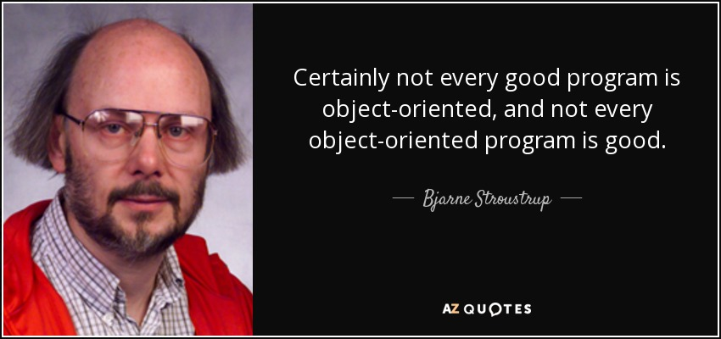
Disadvantages Of Object Oriented Programming:
Now let’s see some disadvantages of object oriented programming, so that you can make your mind clear before choosing one for your applications …
Object oriented programming needs mastery. Programmers should be well-versed with all its concepts like polymorphism and inheritance to code in it. Programs developed using object-oriented programming approach tends to be slower in execution than those developed using procedural programming because object-oriented programming needs a greater number of instructions to execute in a program.

Slide 19
References Used:
1. https://study.com/academy/lesson/oop-object-oriented-programming-objects-classes-interfaces.html
2. https://www.geeksforgeeks.org/operator-overloading-c/
3. https://en.wikipedia.org/wiki/Access_modifiers#:~:text=Access%20modifiers%20(or%20access%20specifiers,are%20only%20three%20access%20modifiers.
4. https://www.javatpoint.com/what-is-data-hiding
5. https://www.codingninjas.com/blog/2020/12/18/difference-procedural-object-oriented-programming/
6. https://en.wikipedia.org/wiki/Object-oriented_programming
7. https://www.youtube.com/watch?v=pTB0EiLXUC8
8. https://www.youtube.com/watch?v=wN0x9eZLix4&ab_channel=freeCodeCamp.org
9. https://www.tutorialspoint.com/pure-virtual-functions-and-abstract-classes-in-cplusplus
10. https://www.programiz.com/cpp-programming/virtual-functions
11. https://www.geeksforgeeks.org/difference-between-constructor-and-destructor-in-c/
12. https://qr.ae/pvFUuk

Slide 20


#include <iostream>
int main()
{
std::cout << "KEEP CODING" << std::endl;
return 0;
}

